Slide 1

(DOM)

Slide 2
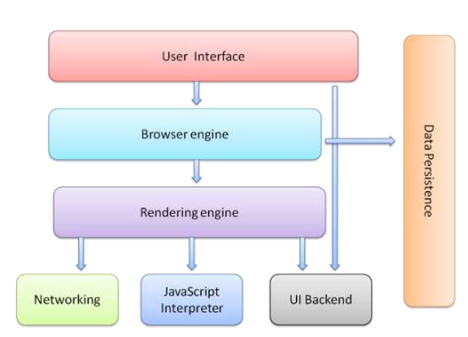
Web Browser Architecture

Slide 3
Document Object Model
When a web page is loaded, the Rendering Engine in the browser creates a Document Object Model tree of the page.
The HTML DOM model is constructed as a tree of Objects:
The HTML elements as objects
The properties of all HTML elements
The methods to access all HTML elements
The events for all HTML elements
*How to get, add, change or delete HTML element

Slide 4
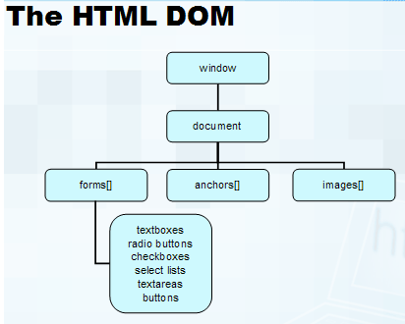
HTML DOM

Slide 5
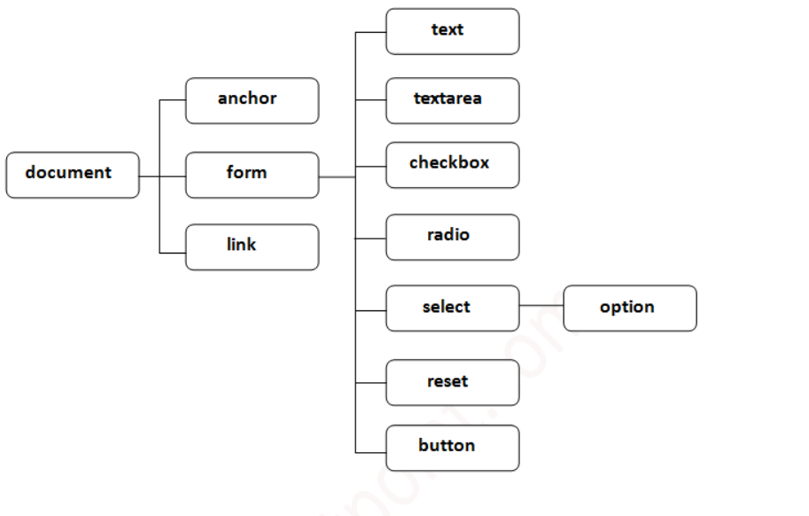
HTML DOM

Slide 6

DOM Tree
The usual parent/child relationship between node
Like any other tree, you can walk this

Slide 7
Referencing Objects
Objects can be referenced
by their id or name (this is the easiest way, but you need to make sure a name is unique in the hierarchy)
by their numerical position in the hierarchy, by walking the array that contains them
by their relation to parent, child, or sibling, parentNode, previousSibling, nextSibling, firstChild, lastChild or the childNodes array

Slide 8
A div example
<div id="mydiv">
This is some simple html to display
</div>
the div is an element with an id of mydiv
It contains a text element, which can be referenced by childNodes[0] (childNode being an array of all children of a node)
So the text in the div is not a value of the div, but rather the value of the first (and only) childNode of the div

Slide 9
Manipulating Objects
As said, it's easiest to reference objects by id
To do this easily, use getElementById(), which returns the element with the given id
For example, if you want to find a div with the id of "mydiv", use document.write(document.getElementById("mydiv").childNodes[0]);
Keep in mind that it's the element itself that's returned, not any particular property

Slide 10
Types of DOM nodes
<p>
This is a paragraph of text with a
<a href="/path/page.html">link in it</a>.
</p> HTML
element nodes (HTML tag)
can have children and/or attributes
text nodes (text in a block element)
attribute nodes (attribute/value pair)
text/attributes are children in an element node
cannot have children or attributes
not usually shown when drawing the DOM tree
*worth reading
https://javascript.info/dom-nodes

Slide 11
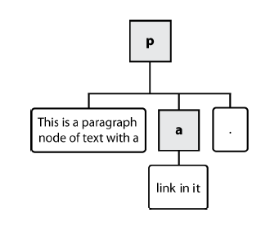
Types of DOM nodes
<p>
This is a paragraph of text with a
<a href="/path/page.html">link in it</a>.
</p> HTML

Slide 12
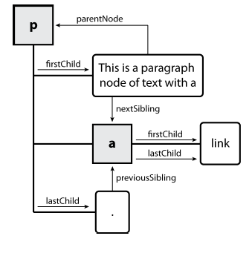
DOM tree traversal example
<p id="foo">This is a paragraph of text with a
<a href="/path/to/another/page.html">link</a>.</p> HTML

Slide 13
DOM Navigation
parentNode
childNodes[nodenumber]
firstChild
lastChild
nextSibling
previousSibling
//first child document.write(document.getElementById("demo").firstChild.nodeValue);
//childNodes[0]
document.write(document.getElementById("demo").childNodes[1].nodeName);
* Try others in LAB Task

Slide 14
DOM Navigation
Method | Description
write("string") | writes the given string on the doucment.
writeln("string") | writes the given string on the doucment with newline character at the end.
getElementById() | returns the element having the given id value.
getElementsByName() | returns all the elements having the given name value.
getElementsByTagName() | returns all the elements having the given tag name.
getElementsByClassName() | returns all the elements having the given class name.

Slide 15
HTML Code Example
<html>
<head>
</head>
<body>
<div id=“demo”>
<H1>Heading1</H1>
<p>First Paragraph</p>
<div>
<ul>
<li><H2>List1 Heading</H2></li>
<li><p>List1 Para</p></li>
<li><p>List2 Para</p></li>
</ul>
<div>
</div>
</div>
<a href="www.google.com">Google</a>
</div><!--First Div-->
<p>Last Paragraph</p>
<script>
</script>
</body>
</html>

Slide 16
HTML DOM Tree
Body
div
p
h1
p
div
a
ul
div
li
li
li
h2
p
p

Slide 17
Change the HTML content of the first <p> element (index 0) in the document:
document.getElementsByTagName("P")[0].innerHTML = "Hello World!";
<script>
function myFunction() {
var x = document.getElementsByTagName("P");
var i;
for (i = 0; i < x.length; i++) {
x[i].style.backgroundColor = "red";
}
}
</script>

